Slide 1
Senior Affairs Point of Sale System Memberships Training Course
Section 7
Alternate Meal and Membership Eligibility/Special Codes (For Meal Sites Only)
Revised December 28, 2016

Slide 2
DSA Memberships Course-Section 7 Alternate Meal Eligibility/Special Codes (For Meal Sites Only)
Congregate Free meal requirements for 60+ Seniors:
Congregate Lunch-60+ Seniors Qualify for a Congregate Lunch Meal at a donation rate that is reimbursed to DSA by the AAA once the Senior has submitted a SAMS form and they are entered into the SAMS system
Reservations-All lunches at meal sites require a reservation. If a person does not have a reservation, they will be asked to wait until all others with reservations have been served. After reservations are served, if there are any meals still available, they will be able to purchase a congregate donation rate.
Tracking-When a person comes into a meal site, the DSA staff will ensure they have a reservation and run their membership card through both Siriusware and the SAMS systems for accurate tracking of congregate meals

Slide 3
DSA Memberships Course-Section 7 Alternate Meal Eligibility/Special Codes (For Meal Sites Only)
Exceptions to 60+ requirement:
There are exceptions where a person other than the 60+ Senior Qualifies for a congregate meal on a donation basis under the AAA and DSA policies as outlined in the next screen.
These meals and exception types are tracked by using Membership Cards and Aggregate cards along with the Special Codes in Siriusware and tracking in the SAMS systems depending on the eligibility type.

Slide 4
DSA Memberships Course-Section 7 Alternate Meal Eligibility/Special Codes (For Meal Sites Only)
Guide for Alternate “Special” Meal Eligibility Requirements at Meal Sites.
The next slides will instruct you on how to use the special codes in the Siriusware System.

Slide 5
DSA Memberships Course-Section 7 Alternate Meal Eligibility/Special Codes (For Meal Sites Only)
Alternate Qualifying Memberships –Benefits and Congregate Meals for Under 60
Under 60 Spouse with Qualified Member-Qualifying Membership (Benefits are the same as the qualifying senior)
To participate in activities and receive same benefits, must be present with the qualified member
Under 60 married to Qualified Member
SAMS form filled out & in SAMS System
Has a membership card – same color as qualified senior
Enter Special Code 32AG Spouse when processing the transaction for a congregate lunch meal
Run Membership card through both Siriusware and SAMS systems
Disabled Child with Qualified Member- Qualifying Membership (Benefits are the same as the qualifying senior)
To participate in activities and receive same benefits, must be present with the qualified member
Disabled Child must be living with the Qualified Member and their address must be the same.
SAMS form filled out & in SAMS System
Has a membership card – same color as qualified senior
Enter Special Code 32AG Disabled with Elder when processing the transaction for a congregate lunch meal
Run Membership Card through both Siriusware and SAMS systems

Slide 6
DSA Memberships Course-Section 7 Alternate Meal Eligibility/Special Codes (For Meal Sites Only)
Alternate Meal Eligibility – (Congregate Meals Only, No other DSA Benefits)
Long Term Volunteer in a Meal Site Kitchen –Membership Card Meal Only
Is volunteering for more than a week
Must be a volunteer in the kitchen or for meal cleanup on the same day of obtaining the congregate meal to qualify
Under 60+ years old
SAMS form filled out & in SAMS System
Has a membership card (blue eligibility membership card) Write Meals Only on the back of the card with permanent black marker.
Run Membership Card through both Siriusware and SAMS
Enter Special Code 32AGVOL in Siriusware when processing the transaction for a congregate lunch meal and scan into the SAMS system
Under 60 & Living in housing attached or contiguous to the Senior Site
Must be under 60 and living in housing attached or contiguous to the Senior Site.
SAMS form filled out & in SAMS system
Use appropriate age eligible Aggregate Card based on the person’s age to process congregate lunch meal transaction
Run age appropriate Aggregate Card through both Siriusware and SAMS
Enter Special Code 32AG Disabled Elder House in Siriusware when processing the transaction for a congregate lunch meal and scan into the SAMS system
One-Time Guest: Applicants can get their first meal without registering (this is a DSA policy, not reimbursed by AAA, all persons getting a meal to be reimbursed by AAA must complete a SAMS form and be entered into the SAMS system).
You must process these transactions with the appropriate age eligibility aggregate card and use the appropriate special code in Siriusware. Scan all aggregate cards through the point of sales system and SAMS. SAMS will pick up the meals that are eligible for reimbursement.

Slide 7
DSA Memberships Course-Section 7 Alternate Meal Eligibility/Special Codes (For Meal Sites Only)
One Day Volunteer in a Meal Site Kitchen– Qualifies for a Meal Only
Must be a volunteer in the kitchen or for meal cleanup on the same day of obtaining the congregate meal to qualify.
How to process the meal transaction for this scenario in the point of sale system:
Use appropriate age eligible Aggregate Card based on the volunteer’s age to process congregate lunch meal transaction
Enter Special Code 32AG Volunteer when processing the transaction for a congregate lunch meal
Run Aggregate Card through Siriusware and SAMS System

Slide 8
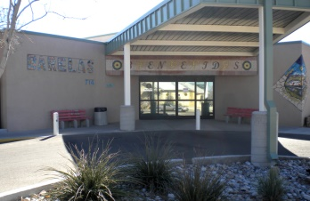
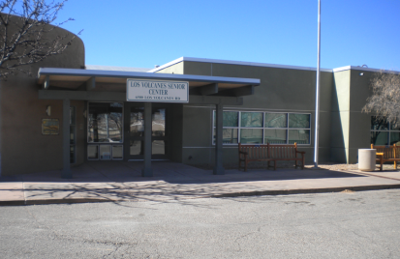
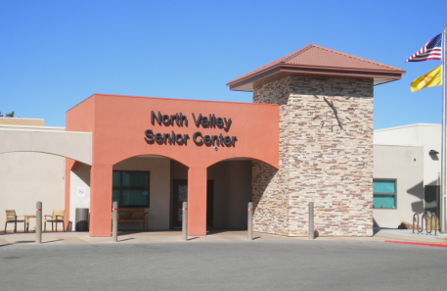
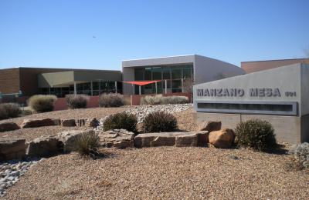
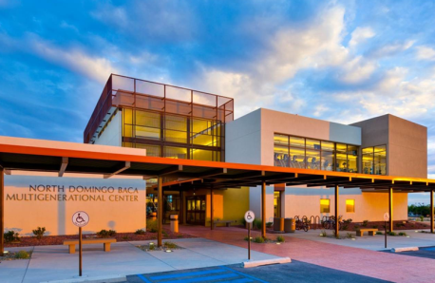
DSA Memberships Course-Section 7 Alternate Meal Eligibility/Special Codes (For Meal Sites Only)
DSA Meal Site: Every lunch meal at a meal site must be accounted for in the Siriusware and SAMS systems. DSA Meal Sites are listed below:
Senior Centers:
Barelas Senior Center
North Valley Senior Center
Los Volcanes Senior Center
Multigenerational Centers:
Manzano Mesa Multigenerational Center
North Domingo Baca Multigenerational Center

Slide 9
Special Eligibility Exceptions Guide
Scenario | Alternate Eligibility/System Special | Card Color
Spouse Under 60 Years of age | Eligible for Lunch on a donation basis under AAA – Needs to fill out SAMS form and entered into SAMS system (32AG Spouse) | Same card color as qualified senior. Eligible for Title III congregate meal. A spouse under 60 is also eligible to participate in Activities/Trips, etc. with qualified senior present. Remember to scan through Siriusware and SAMS systems.
Disabled Child living with Qualified Senior 60+ | Eligible for Lunch on a donation basis under AAA – Needs to fill out SAMS form and entered into SAMS system (32AG Disabled Elder House) | Same card color as qualified senior. Eligible for Title III congregate meal. Meals are reimbursable under AAA for disabled child living with a qualified senior. Can participate in Activities/Trips, Etc. same as qualified senior with qualified senior present. Remember to scan through Siriusware and SAMS systems.
Caregiver of a senior over 60 who is under 60 | Not Eligible for Title III Meal – Pay full price. | None. Issue membership regularly based on caregiver age eligibility. A caregiver can qualify based on their age if they are 60+. In all other cases, caregivers, whether paid or not, are not eligible under AAA for a congregate meal.
Volunteer in a Meal Site Kitchen Under 60 Must be volunteering in kitchen or meal cleanup on day of meal to be eligible. Scenario: Mary is a 16 year old volunteer who helped clean up after lunch today. | Eligible for lunch on a donation basis under AAA – Needs to fill out SAMS form and be entered into SAMS system. (32AG Volunteer) | Issue appropriate membership card based on age and register in SAMS (White, Blue or Yellow) Only qualified for a meal when they have done volunteer work associated with the meal that day. The front desk staff should have a list of the meal site kitchen volunteers to ensure that the person is on the list when they run this process with the correct special eligibility code in the system.
Under 60 living in a Senior Housing Community. This is a person living in a Senior Housing facility attached to or contiguous to a meal site/center such as Barelas (senior housing to the east) | Eligible for free lunch (Donations encouraged) under AAA – Needs to fill out SAMS form and entered into SAMS system. Under 60 living in a Senior Housing Community eligibility class, you will choose the Special Code: (32AG Elder House) | Issue appropriate membership card based on age and register in SAMS (White, Blue or Yellow) Choose the Special Code (32 AG Elder House) when processing the meal transaction under this exception.
One-time Guest Exception | (32AG Other) | Use Aggregate card and choose the Special Code (32AG Other) when processing a lunch meal under this exception.

Slide 10
DSA Memberships Course-Section 7 Alternate Meal Eligibility/Special Codes (For Meal Sites Only)
B
A

Slide 11
A
B

Slide 12
Note: You will be taken back to the main screen and you will see the Special button now reflects the specific eligibility exception you chose.
Click the Finalize button to complete the transaction.

Slide 13
DSA Memberships Course-Section 7 Alternate Meal Eligibility/Special Codes (For Meal Sites Only)
Congratulations! You have completed Section 7- Alternate Meal Eligibility/Special Codes for the DSA Memberships Course

